Slide 1

Household Heterogeneity in a Multi-Regional Energy-Economic Model: Distributional Impacts of Energy Policies
Montenegro
Roland

Slide 2
Agenda
Introduction
Methodological implementations
Household consumption
Elasticity of substitution between energy and housing services
Environmental tax reform (ETR)
Scenarios
Results
Limitations and insights
Next steps

Slide 3
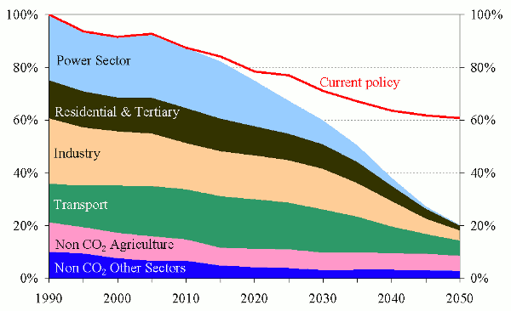
Introduction
European Emission target
The burden has to be distributed among all the sectors in the economy.
Old Policies
Current targets
Source: EC
https://ec.europa.eu/clima/policies/strategies/2050_en

Slide 4
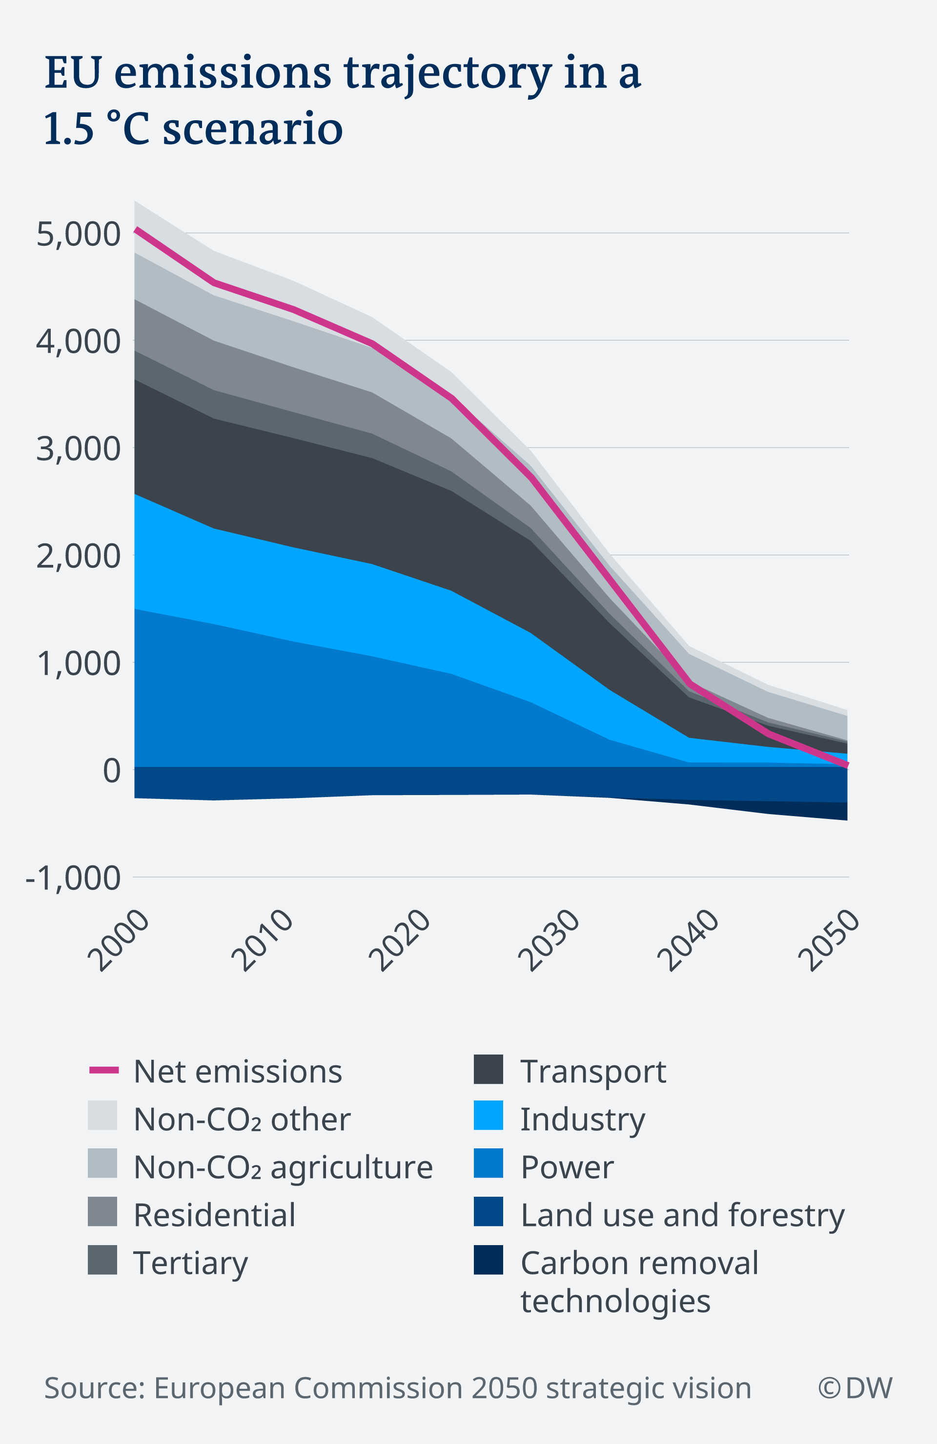
Introduction
European Emission target
New targets increase the European ambition to reduce the emissions by 55% in 2030, compared to 1990 levels.
Reach carbon neutrality by 2050.
EU Green Deal
Group of policies in several areas to ensure sustainable economic growth

Slide 5
Introduction
Distributional impacts
What are they?
Distributional impacts refer to the case when different household groups or individuals are affected by a policy to a different degree.
Commonly associated with inequality
Differences in environmental burden
Distribution of income
Distribution of welfare
Access to energy (and carbon)

Slide 6



Introduction
Distributional impacts – Growing attention
2030 Agenda for Sustainable Development by the United Nations
17 Social Development Goals (SDGs)
3 of which are directly connected to either energy or inequality
https://sdgs.un.org/goals

Slide 7

Introduction
Distributional impacts – Growing attention
Yellow vest movement
Originally, the yellow vest protesters were people from rural areas who have to drive long distances as part of their daily life.
Their initial demand was to repeal the green tax on diesel. Now, others want the current minimum wage (about $1,350 per month after taxes) to be raised.
https://www.npr.org/2018/12/03/672862353/who-are-frances-yellow-vest-protesters-and-what-do-they-want?t=1607006502419

Slide 8
Introduction
Objective
In light of the side effects of energy and climate policies in terms of income distribution and burden sharing, my main objectives are:
Development of a technically based method to represent distributional impacts in the household sector.
Analyze policy alternatives that aim on mitigating negative distributional effects of energy and climate policies

Slide 9
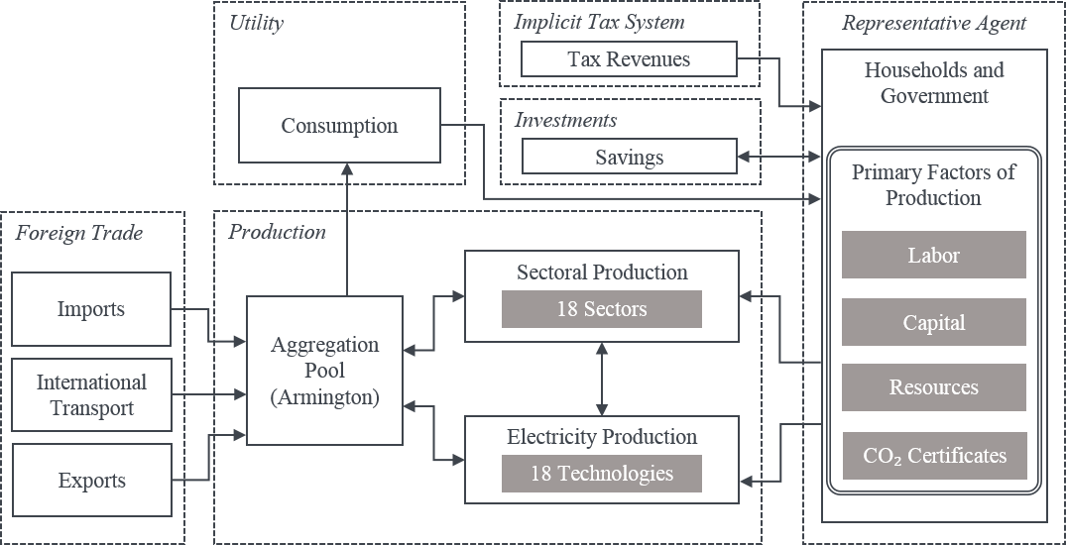
Methodology
NEWAGE
NEWAGE was not able to display distributional impacts on a household level because it represented the households as one homogenous actor.
In order to display them, the first step was to disaggregate the representative agent into income quintiles and the government.

Slide 10
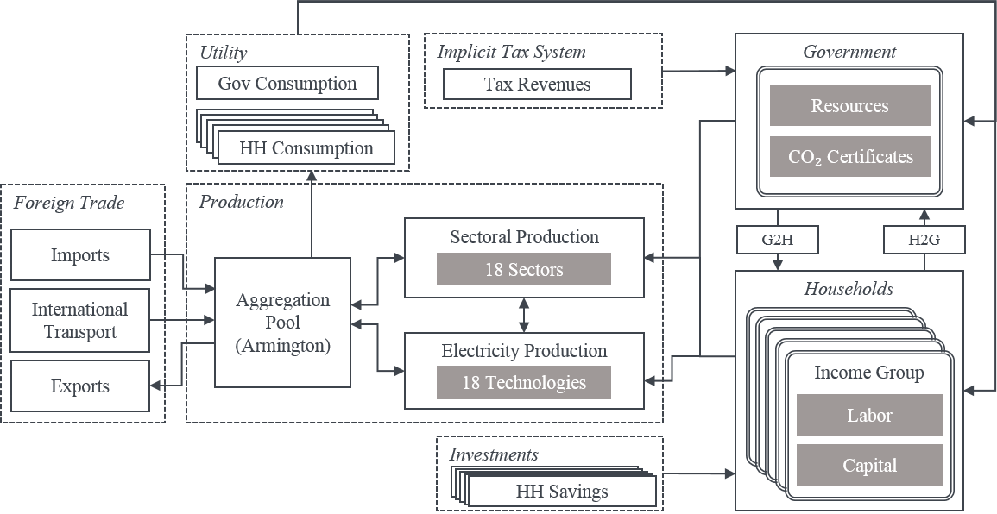
Methodology
NEWAGE – Multiple households
Specific consumption function for each income group
Explicit modeling of tax transfer
Specific labor and capital endowment
Specific saving propensity for each income group

Slide 11
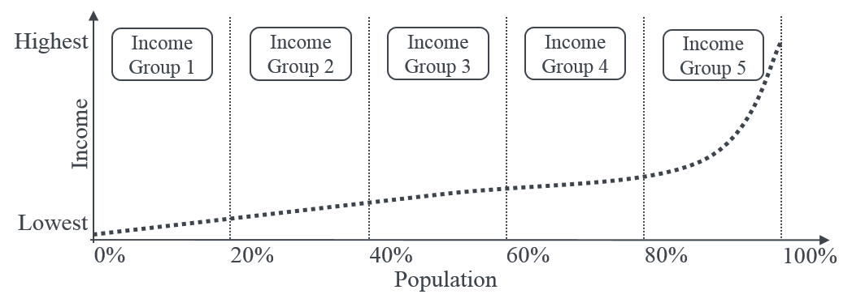
Methodology
NEWAGE – Multiple households
Households are divided in income quintiles.
Households are ordered according to their income and divided into 5 groups of equal size.
Each quintile contains 20% of the population.

Slide 12
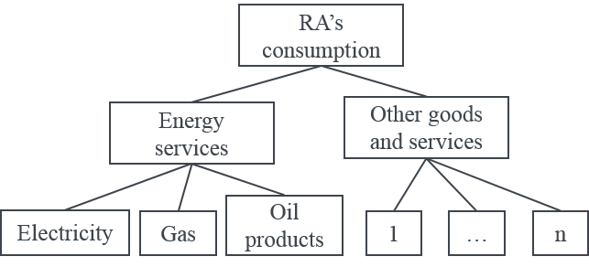
Methodology
NEWAGE – Households energy consumption
The original nesting for household consumption grouped energy services separated from all other sectors.
This representation captures only rudimentary the substitution between energy goods and housing improvement.

Slide 13
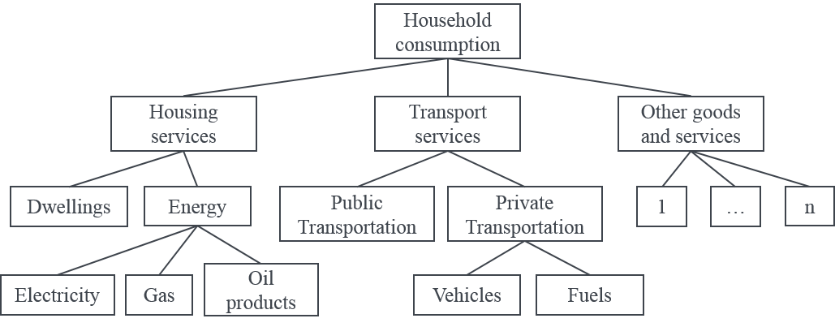
Methodology
NEWAGE – Households energy consumption
The new representation, based on Bye et al. 2017* , allows for a better representation of the consumption of energy goods and direct substitutes.
Energy for heating can be substituted by consumption of dwelling services, which can represent either improving thermal isolation or the payment of higher rent for a more efficient housing.
* https://doi.org/10.1016/j.energy.2017.10.103

Slide 14
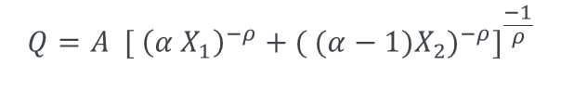
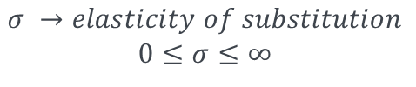
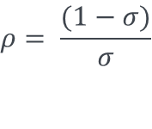
Methodology
Households energy consumption – Elasticity of substitution
$$σ →elasticity of substitution$$
$$0≤σ≤∞$$
Housing services
Constant Elasticity of Substitution (CES)
Function
Dwelling services
Energy
$$Q=A {[ {\left(α X_{1}\right)}^{−ρ}+{( (α−1)X_{2})}^{−ρ}]}^{\frac{−1}{ρ}}$$
Construction
Rent
Electricity
Gas
Oil products
$$ρ= \frac{(1−σ)}{σ}$$

Slide 15
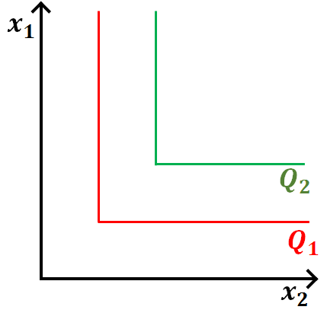
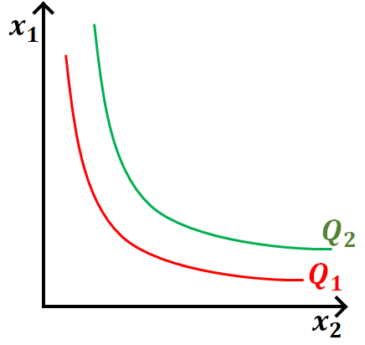
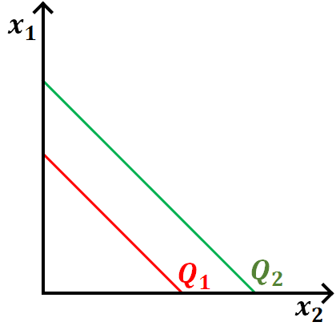
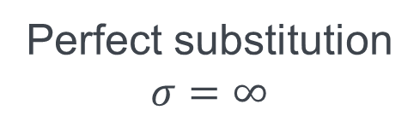

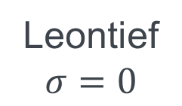
Methodology
Households energy consumption – Elasticity of substitution
Leontief
$$σ=0$$
Cobb-Douglas
$$σ=1$$
Perfect substitution
$$σ=∞$$
Where “Q” represents the level of production
Notes:
Leontief: fixed proportions (knife which has a metal blade and a wooden handle)
Cobb-douglas: labor-capital
Perfect substitution:

Slide 16
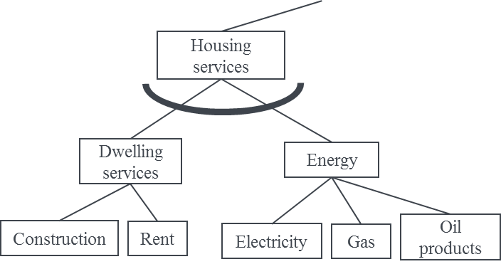
Methodology
Households energy consumption – Elasticity of substitution
Aggregate investment options for thermal isolation

Slide 17
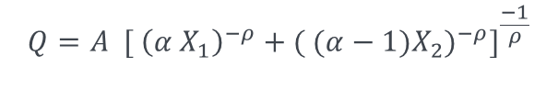
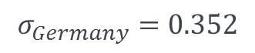
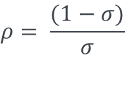
Methodology
Households energy consumption – Elasticity of substitution
$$Q=A {[ {\left(α X_{1}\right)}^{−ρ}+{( (α−1)X_{2})}^{−ρ}]}^{\frac{−1}{ρ}}$$
Fit
$$ρ= \frac{(1−σ)}{σ}$$
$$σ_{Germany}=0.352$$
Repeat the process for each of the 8 remaining EU regions

Slide 18


Environmental Tax Reform
Double dividend hypothesis
Concept
It refers to the notion that environmental taxes can both reduce pollution (the first dividend) and reduce the overall economic costs associated with the (suboptimal) tax system by using the revenue generated to displace other more distortionary taxes that slow economic growth at the same time (the second dividend).
1. Lower emissions
2. Better economic output
https://www.eea.europa.eu/help/glossary/eea-glossary/double-dividend#:~:text=with%20javascript%20off.-,Term,time%20(the%20second%20dividend).

Slide 19
Environmental Tax Reform
What researchers say?
Authors agree that in addition to the economic dividend, there can be other benefits (other dividends) from ETRs:
Employment increase
Fair income distribution
Progressive taxation
However, these dividends do not always happen and ETR options have to be investigated in a case by case basis in order to assess which dividends appear for each policy option.
https://www.eea.europa.eu/help/glossary/eea-glossary/double-dividend#:~:text=with%20javascript%20off.-,Term,time%20(the%20second%20dividend).

Slide 20
Scenarios
Reduction of overall energy-related CO2 emissions
Reference scenario [REF]
Considers the economic effect of Covid in 2020
Reduction in ESD sectors only through technology development
Reduction Scenario [CME]
Also known as “Current mechanisms” from ARIADNE project
Overall emissions reduction of 53% in 2030 compared to 2005 levels
62% reduction in ETS sectors and 44% reduction in ESD sectors

Slide 21
Scenarios
Environmental Tax Reform Scenarios
The Environmental tax reform scenarios consider that the emission targets in the ESD sectors are reached through a national cap-and-trade system and the revenues are used in one of the four schemes:
No revenue recycling – Status Quo [CME]
Per capita redistribution [CME_cap]
Reduction of Labor tax [CME_lab]
Reduction of Value added tax (VAT) [CME_vat]

Slide 22
Results
GDP - Germany
Average yearly growth per scenario
Years | REF | CME | CME_cap | CME_vat | CME_lab
2011-2020 | 0.515%
2020-2030 | 1.935% | 1.814% | 1.810% | 1.814% | 1.952%
In terms of GDP development, only scenario CME_lab presents the economic dividend.
The remaining scenarios all present a GDP loss of around 0.7% and 1.2% compared to REF in 2025 and 2030 respectively.

Slide 23
Results
Income distribution – Gini Index
All scenario present better Gini Coefficients than REF.
On the other hand, CME_lab present a lower value than CME
CME_cap has the best results in terms of income distribution

Slide 24
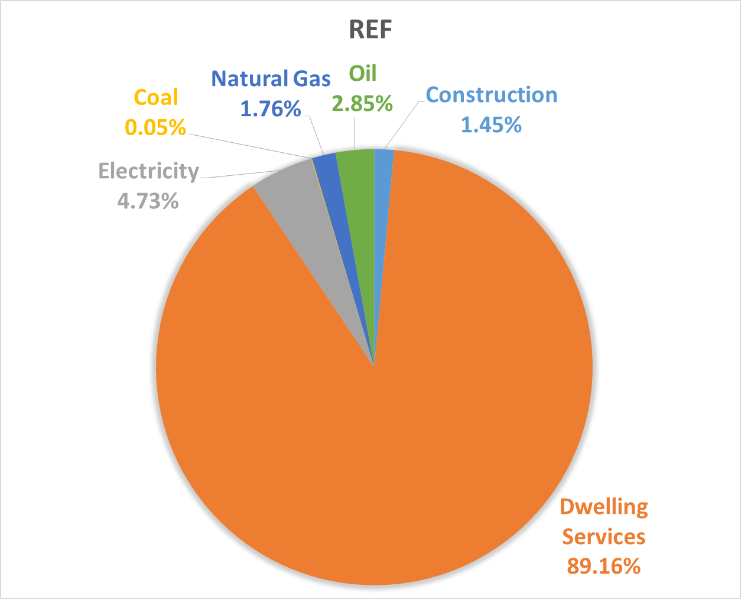
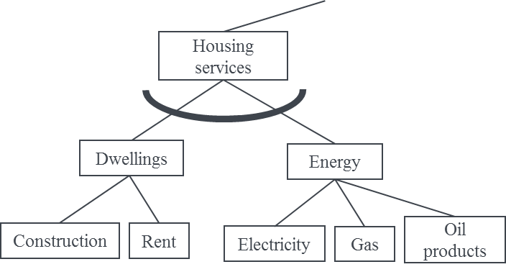
Results
Consumption of housing services in 2030
Sum over all households
Energy substitution

Slide 25
Results
Energy substitution
In all scenarios we see higher consumption share of dwelling services, electricity and a small increase in construction
The fossil fuels, as expected, all reduce their consumption

Slide 26
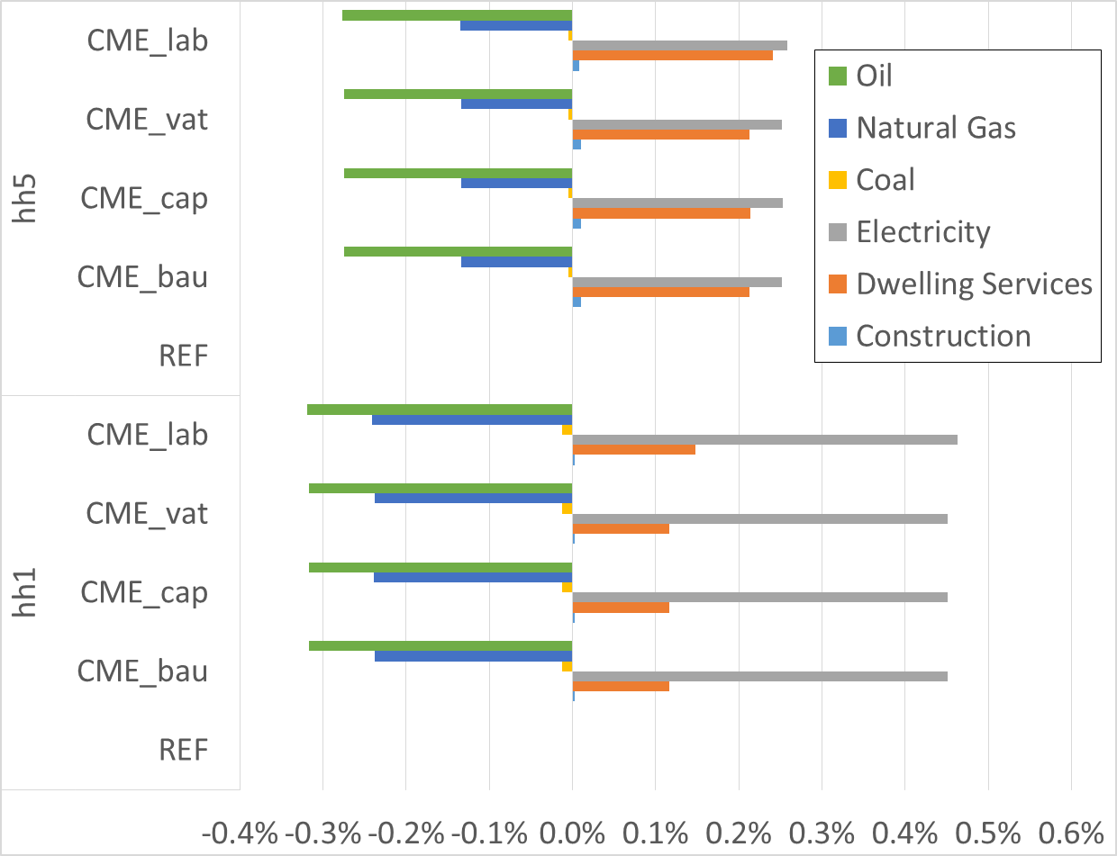
Results
Energy substitution
When looking at the difference in consumption according to income group, it is possible to see that low-income households are more prone to use electricity.
High-income households still can afford carbon taxation and are less pressured to substitute their fossil-fuel consumption

Slide 27
Limitations
Heating technologies, such as heat pumps, are not explicitly modeled.
Instead, technology development is represented by:
Autonomous Energy Efficiency Index
Higher consumption of electricity
Access to data regarding energy consumption per household is limited.
Knowing the distribution of electricity usage for transportation per income group could help plan better policies for EV adoption in low-income households

Slide 28
Insights and impacts
Including distributional impacts in policy analyses helps identifying winners and losers of different policy packages.
CME_lab leads to higher GDP growth, but higher inequality
CME_cap leads to GDP stagnation compared to CME, but lower inequality
These results can help policy makers decide what kind of economic growth to prioritize in the coming years
Although not the case in these results, high changes in energy demand from different recycling schemes can be fed to energy system models, which sometimes lack the feedback between income and energy demand.

Slide 29
Next steps
Modeling:
Calibration of the model to account for the household disaggregation
Calculation of final scenarios
Text:
Introduction and literature review: making corrections
Methodology: 50%
Missing: Results and Conclusion

Slide 30
Next steps
Publications:
Carbon leakage and competitiveness: Socio-economic impacts of greenhouse gas emissions decrease on the European area until 2050 (2017 – Main author)
Long-Term Distributional Impacts of European Cap-and-Trade Climate Policies: A CGE Multi-Regional Analysis (2019 – Main author)
On the Way to a Sustainable European Energy System: Setting Up an Integrated Assessment Toolbox with TIMES PanEU as the Key Component (2020)
Beyond the Energy System: Modeling Frameworks Depicting Distributional Impacts for Interdisciplinary Policy Analysis (2020 – Main author – review article)

Slide 31

IER
Roland Cunha Montenegro
roland.montenegro@ier.uni-stuttgart.de
87833
87873
Institut für Energiewirtschaft und Rationelle Energieanwendung (IER)
Heßbrühlstraße 49a, 70565 Stuttgart

Slide 32
Questions?

Slide 33
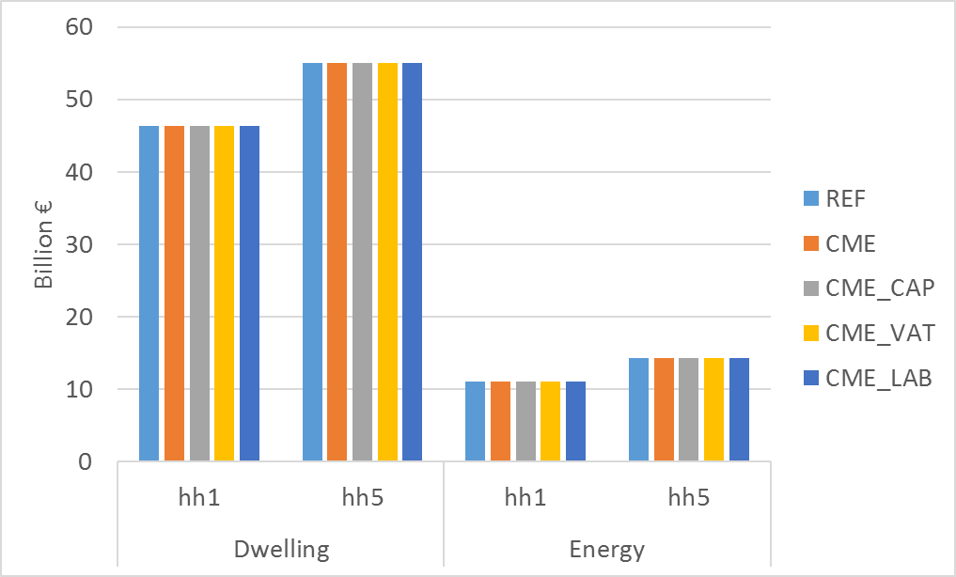
Results
Consumption – Energy x Dwellings split (2011) - Germany

Slide 34
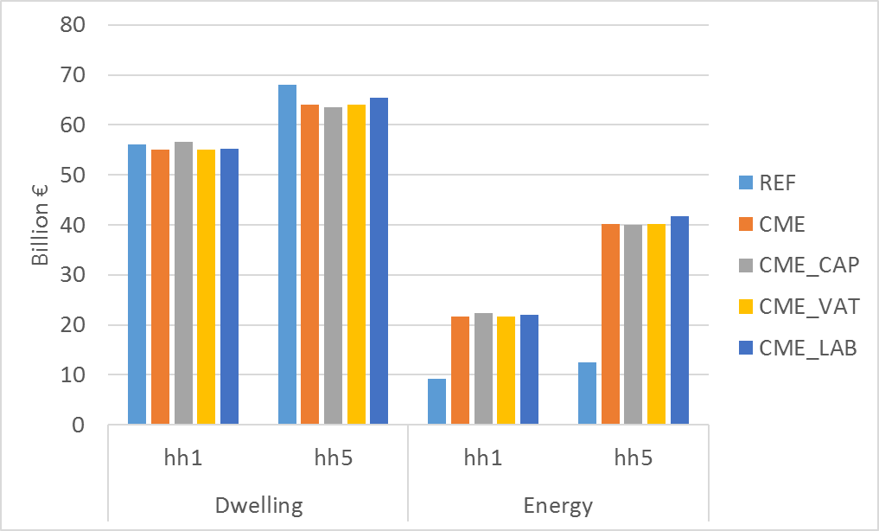
Results
Consumption – Energy x Dwellings split (2030) - Germany

Slide 35
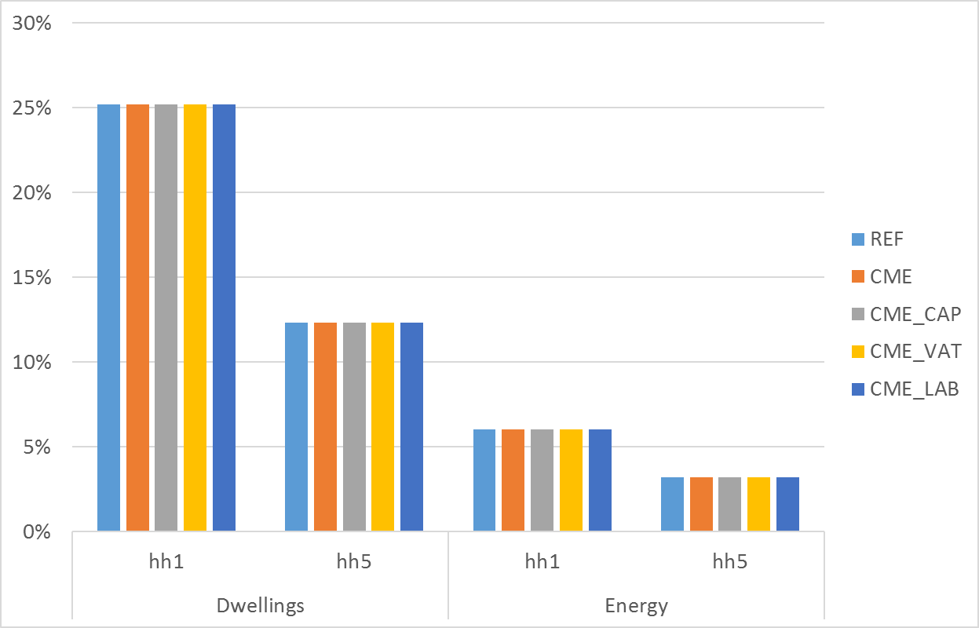
Results
Share of total income – Energy x Dwellings split (2011) - Germany

Slide 36
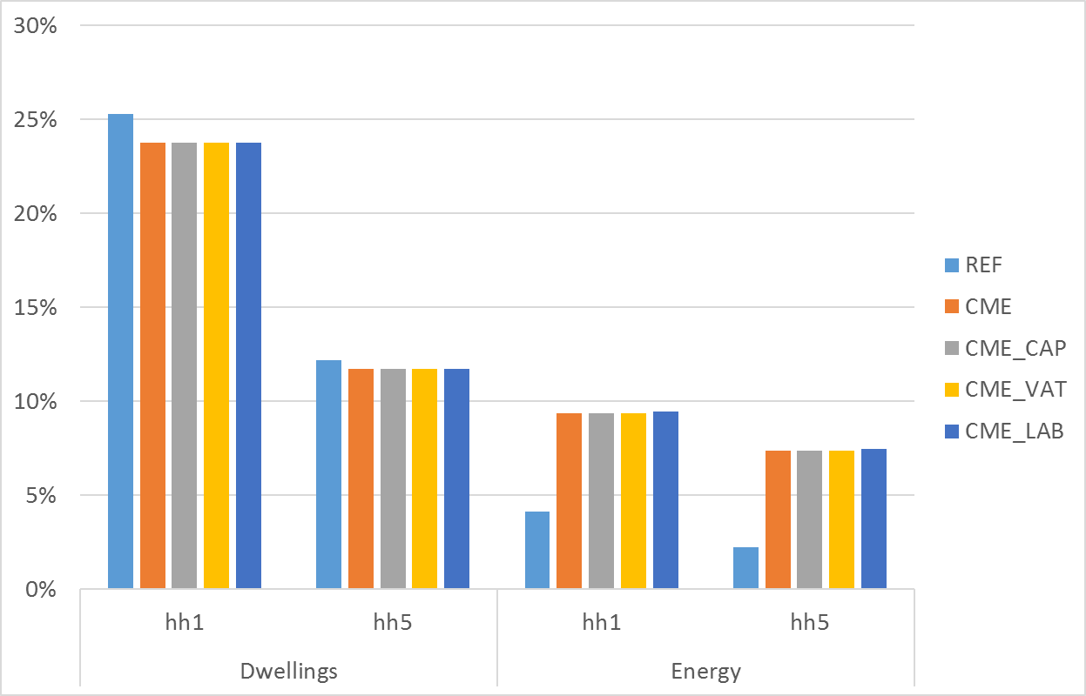
Results
Share of total income – Energy x Dwellings split (2011) - Germany

Slide 37
Scenario – Low income first

